Slide 1
Progress Overview by Team 1
TTS Development Documentation
05.07.2023

Slide 2
Table of Contents
Aims of the project
Assessment of previous approaches
Our first objective
What we know
Festival documentation implementation
Phonetic transcription format
Diphone database struggles
Creating our own diphone database

Slide 3
Aims of the project
To create a voice that could produce non-English utterances
In doing so, learn the individual elements of a TTS
Learn the basics of the Scheme programming language to work with Festival or potentially other programs
Familiarize ourselves with the typical aspects of programming, e.g.:
Researching solution approaches
Translate approaches into our specific context
Problem solving
Trying out new code and ideas
Notes:
Asrida

Slide 4
Assessment of previous approaches
2 main concepts
Modifying kal’s pre-existing phoneset and lexicon, but using the code framework of its SCM-file
Creating a new voice from scratch, building our own SCM-file, phoneset, lexicon etc.
Kal’s lexicon for example had already been successfully modified (e.g. by Roman)
However, we decided on the second approach, attempting to build an entire voice ourselves
Notes:
Asrida

Slide 5
Our first objective
For starters, we wanted to create a voice that could produce three specific words
This was to be a foundation we could improve upon for a complete voice
Language: German
First approach: following the Festival documentation (24.2 Building a new voice), but also taking a look at the structure of other voices’ SCM-files, similar to our pre-project work
But: adapt it for our purposes
Notes:
Mara

Slide 6
What we know
We knew we needed:
A phoneset: specifies the phones used to transcribe the input text
A lexicon: contains phonetic transcriptions of words, including stress, that the TTS can look up
LTS (Letter-to-Sound) rules: the LTS ruleset specifies how words (letters) should be transcribed into phones (sound) for words that don’t exist in the lexicon
A diphone database: contains the diphones that the TTS uses for speech synthesis
Notes:
Mara

Slide 7
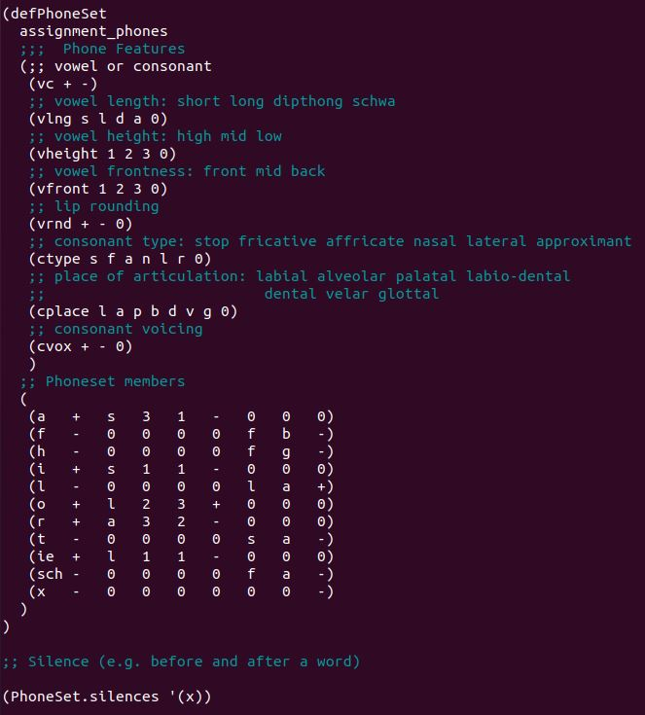
Festival documentation implementation
1. Write a German phoneset
For now, only including the phones from our three chosen words
As well as including a silence phone, for example for pauses between words
At first, the orthographic representations of the necessary phones were chosen arbitrarily
Notes:
Luca

Slide 8
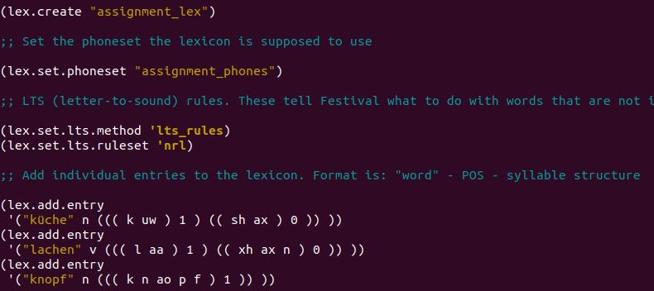
Festival documentation implementation
2. Create a lexicon
Set the phoneset the lexicon should use to our German phoneset
Add entries for our words, including stress and Part-of-Speech markers
3. Specify LTS rules
For our first aim of producing three specific words, the LTS would not come into play
Therefore we simply chose the NRL ruleset, even though it is designed for English
Notes:
Luca

Slide 9
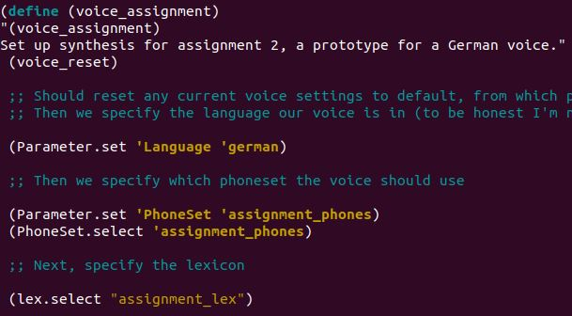
Festival documentation implementation
4. Define our voice
Set the parameters for our voice, that means telling Festival to use our modules
This includes the waveform synthesis module, see next slide
Notes:
Luca

Slide 10
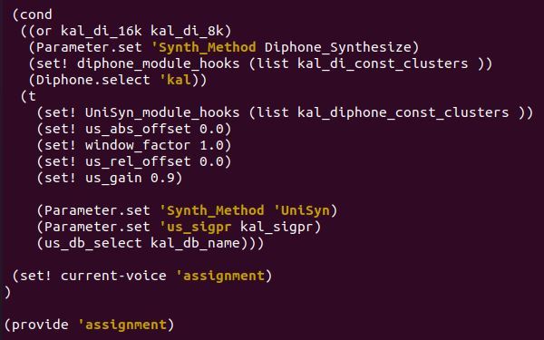
Festival documentation implementation
5. Waveform synthesis
Here we specify which synthesis method and diphone database our voice should use
For this approach, we used kal’s diphone database and took the relevant code from it’s SCM-file
Notes:
Roman

Slide 11
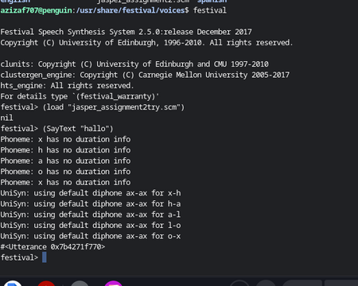
Festival documentation implementation
As we focussed on creating the most fundamental voice for a start, other modules, e.g. for phrasing or intonation, were not implemented
This process was largely successful (phoneset and lexicon creation, voice could be selected)
However: a couple of errors
For one, Festival requires that a duration method be specified, as can be seen by this error message
Notes:
Roman

Slide 12
Festival documentation implementation
To solve this, we specified the duration parameter in our voice definition through this line:
(Parameter.set ‘Duration_Method ‘Default)
The other issue was that the voice could not produce the words due to not finding any of the diphones in kal’s diphone database
Notes:
Roman

Slide 13
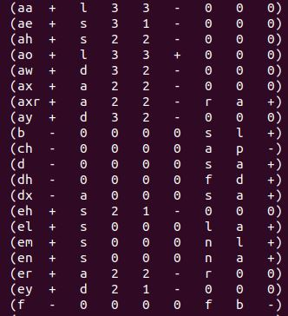
Phonetic transcription format
This was due to a mismatch in the format of the phonetic transcription in our phoneset/lexicon and kal’s diphone database
While our files did not use an official format, kal uses Arpabet, which looks like this:
Notes:
Jasper

Slide 14
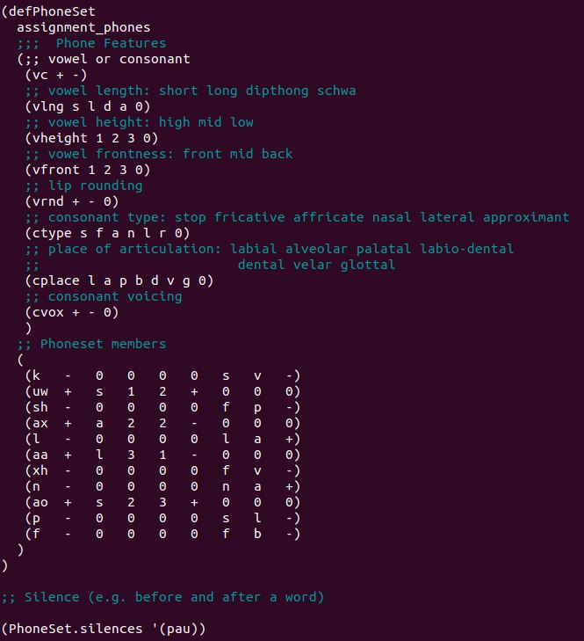
Phonetic transcription format
As a result, we had to reformat our files into Arpabet
Problem: Arpabet was designed specifically for English
Consequently, some German phones do not have an Arpabet transcription
So, instead we used LumenVox, which is a transcription based on Arpabet, but designed to work for German as well
It looks like this:
Notes:
Jasper

Slide 15
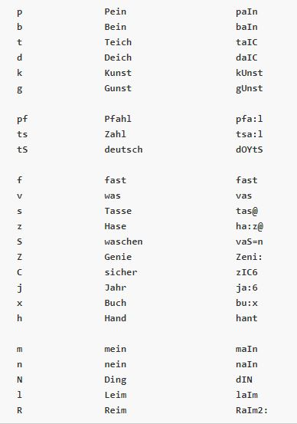
Phonetic transcription format
During our research, we found another interesting transcription format: SAMPA
This format is also designed for German phones, and for example the German de4 voice from the MBROLA project uses this
However, since the format needs to be the same for phoneset, lexicon and diphone database, kal’s Arpabet dictated the format
Notes:
Jasper

Slide 16
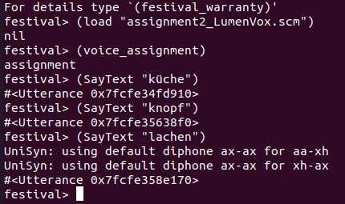
Phonetic transcription format
Back to our voice
The LumenVox implementation of our voice worked to a certain extent
As LumenVox is based on Arpabet, sounds that occur in both English and German could successfully be recognized by Festival and retrieved from kal’s diphone database
However, sounds that do not exist in English, and therefore are not contained in kal’s diphones, could logically not be produced (such as German [x] in lachen, transcribed here in LumenVox as “xh”)
Notes:
Jasper

Slide 17
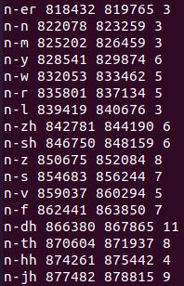
Diphone database struggles
To solve this, we at first considered if we could manually add the missing German diphones to kal’s diphone database
But after researching the functionality of diphone databases in Festival, we realized that they made use of audio files
The .group-file lists all diphones existing in these audio files, alongside exact timings on where in the files they can be found
Festival then “pulls out” these diphones when they are needed for an utterance
→ Ergo, manually adding diphones is not possible
Notes:
Aziza

Slide 18
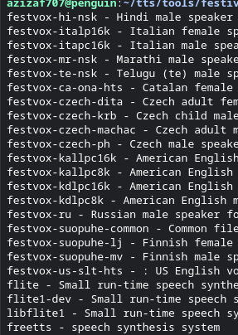
Diphone database struggles
Our next idea: instead of using the English kal voice, we could use diphones from a German voice
First thought: Festival itself has some additional voices in other languages available for download
apt-cache search festvox-*
Unfortunately, the only German Festival voice we are aware of (the University of Stuttgart’s IMS German voice) is no longer accessible through Festival, and could also not be obtained from the University’s webpage or anywhere else in the Internet
Notes:
Aziza

Slide 19
Diphone database struggles
Next idea: use one of MBROLA’s German voices
MBROLA should have support for Festival integration, and we found some documentation on this:
https://www.cstr.ed.ac.uk/projects/festival/mbrola.html (Official page of the University of Edinburgh)
https://ubuntuforums.org/showthread.php?t=751169 (Detailed HOWTO guide from the Ubuntu forums we already looked at earlier in the course)
However, just as when we did try to implement MBROLA earlier, these efforts proved unfruitful yet again
Notes:
Aziza

Slide 20
Diphone database struggles
The main issue seems to be that all the documentation we could find worked with a specific webpage of the MBROLA project and utilized files that were obtainable there
But: as these documentations were written about 15 years ago, this page seemingly no longer exists, and neither does any other official MBROLA webpage outside of its GitHub repositories
plot twist a functioning bash script to install MBROLA and voice files: https://github.com/pettarin/setup-festival-mbrola
repository of the MBROLA developers:
https://github.com/numediart/MBROLA https://github.com/numediart/MBROLA-voices
Notes:
Aziza

Slide 21
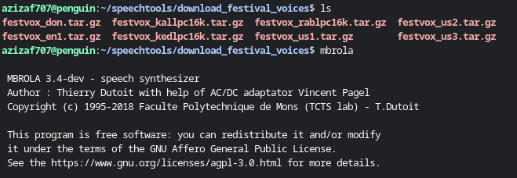
investigating the use of MBROLA (open)
MBROLA and
English voices
installed
open questions: organisation in the directories, syntax in .scm file, developing own voices using the MBROLATOR

Slide 22
Diphone database struggles
However, the HOWTO explains three other options for integrating foreign voices into Festival:
The CMU Arctic voices
The CMU Indic voices
And the Nitech HTS voices
But after taking a closer look at these resources, we discovered that there are no German voices among them (CMU Arctic voices are exclusively English, while Nitech HTS voices are either English or Japanese and CMU Indic covers Hindi,Tamil, Telugu and Marathi), rendering them unhelpful to our project
Lastly, we tried to scour the internet for any kind of other publicly accessible German diphone databases, but none that we could integrate into Festival could be found
Notes:
Andre

Slide 23
Diphone database struggles
Consequently, we had to abandon our plan of using a German diphone database for our voice
At this point, we weren’t exactly sure what the best way to proceed was
But, after the other group kindly shared their approach and progress, we have come to agree that their approach of using kal’s diphones and trying to map a German phoneset/lexicon/LTS ruleset onto it as well as possible is probably the best approach available to us
Notes:
Andre

Slide 24
Creating our own diphone database
An entirely new approach: create a diphone database from scratch
This would circumvent the issue of having to find a satisfactory pre-existing diphone database
Recordings were made and transcribed in order to use Festival’s diphone database creation capabilities
A German phoneset was built based on LumenVox
A LTS ruleset was created, but due to time constraints it does not account for all phonological rules of German pronunciation
The next step would be to specify the pitch range of our speaker
Notes:
Andre

Slide 25
Thank you for your attention!

